Slide 1

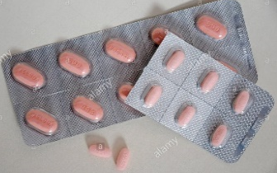





How to take your Capecitabine tablets
Capecitabine
They are either 500mg or 150mg tablets
2. The instructions on the boxes will tell you the dose and how many tablets you need to take. You may need a combination of 500mg and 150mg
3. Store the tablets at room temperature.
Store away from children
Store in a cool dry place.
4. Take TWICE a DAY (9-12 hours apart) with or just after food
5. Take the tablets within 30 minutes of finishing a meal. It can be a light snack i.e. toast
6. Press the tablets through the foil into a medicine cup.
If a family member is helping you they should not touch the tablets.
7. Swallow the tablets whole with water.
Do not chew
Do not crush
8. Wash hands thoroughly after handling the tablets
Ring the treatment helpline immediately if you
Take too many tablets
Forget to take your tablets
If you are vomiting or feeling sick
If you have a temperature of 37.5 or more or less than 35.5.
9. You will have a telephone call 1 week after starting your first cycle of tablets.
This is to check if you have any side effects from the treatment and are managing to take the tablets OK.
Please DO NOT wait for the telephone call if you are feeling unwell. Contact the treatment helpline immediately (02920 615 888)

Slide 2
Day | AM | PM | comments | Day | AM | PM | comments

